Slide 1

GRAPH THEORY AND ITS APPLICATIONS
Dr. Arti Arya
Department of Computer Science & Engineering

Slide 2
GRAPH THEORY AND ITS APPLICATIONS
Graph Coloring
Dr. Arti Arya
Department of Computer Science & Engineering

Slide 3
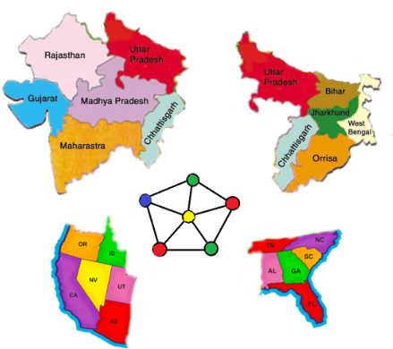
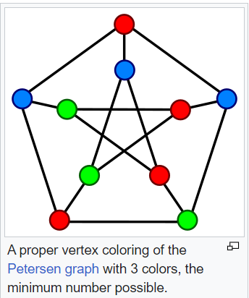
Graph Theory and its Applications Graph Coloring
Graph Coloring Problem
Given a graph, color all the vertices so that two adjacent vertices get different colors.
Graph Coloring is an assignment of colors (or any distinct marks) to the vertices of a graph.

Slide 4
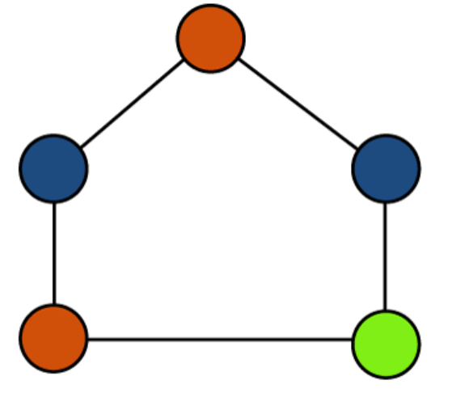
Graph Theory and its Applications
Graph Coloring
Graph Coloring: A graph coloring is stb a proper coloring if no two adjacent vertices have the same color.
Chromatic Number: The chromatic number of a graph is the minimal number of colours needed to colour the vertices in such a way that no two adjacent vertices have the same colour.
In the example above, the chromatic number is 3.

Slide 5
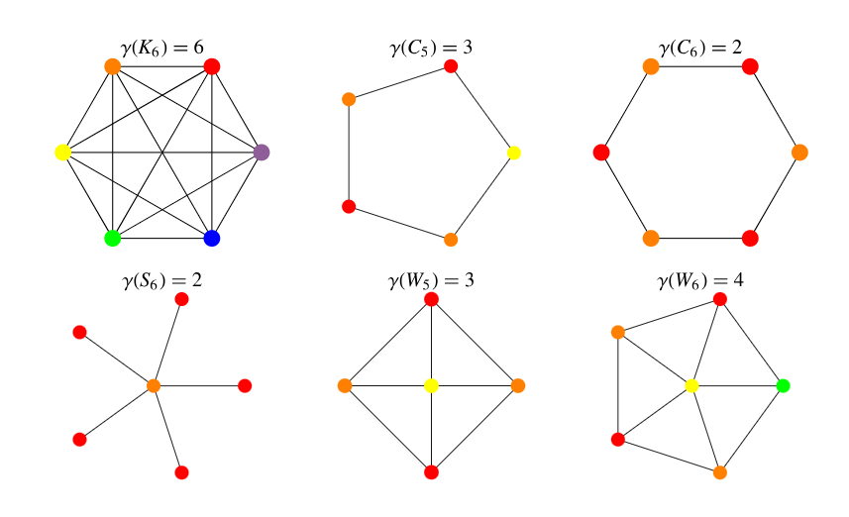
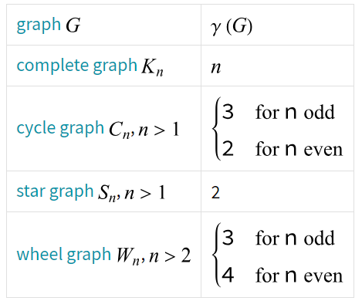
Graph Theory and its Applications
Graph Coloring
https://mathworld.wolfram.com/ChromaticNumber.html

Slide 6
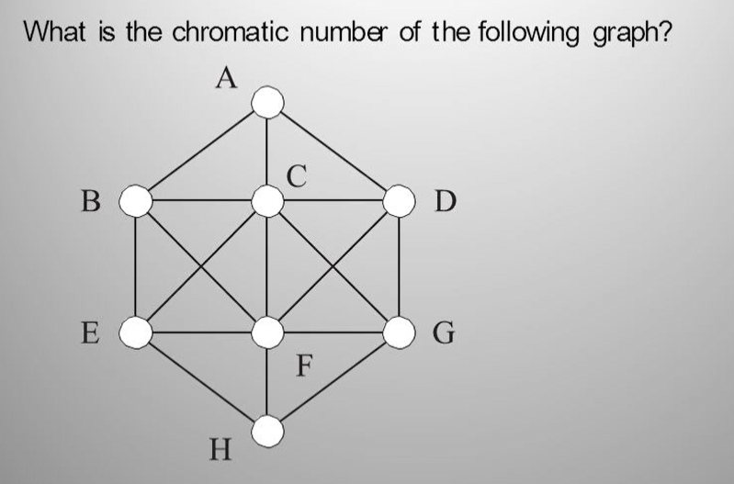
Graph Theory and its Applications
Graph Coloring

Slide 7
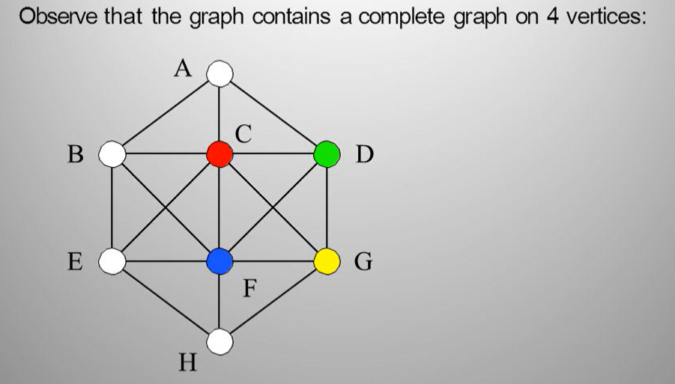
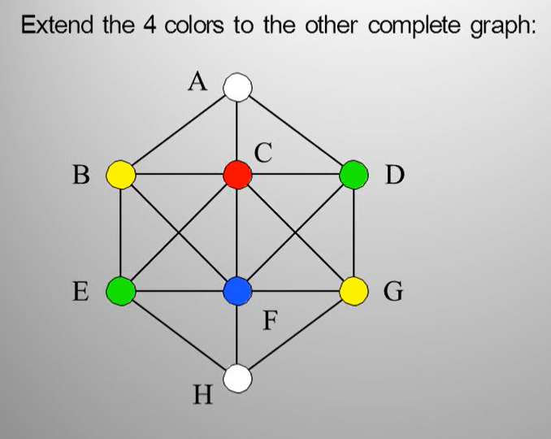
Graph Theory and its Applications
Graph Coloring

Slide 8
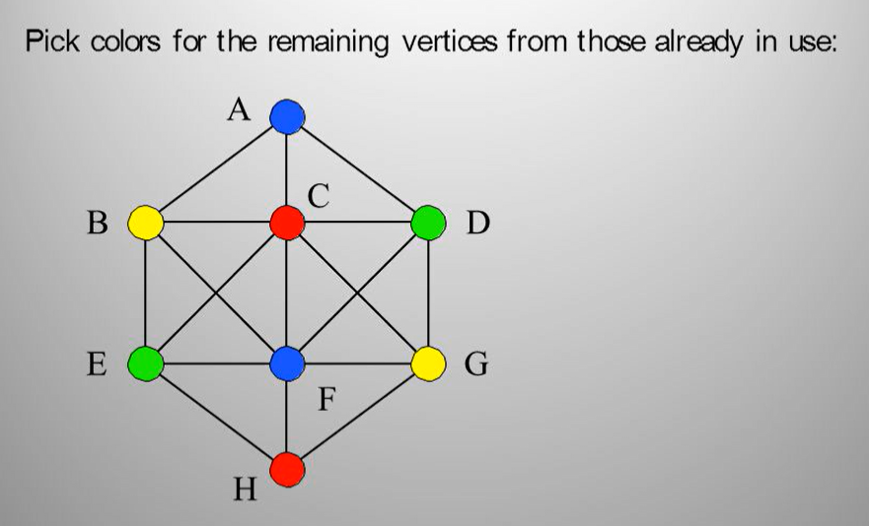
Graph Theory and its Applications
Graph Coloring

Slide 9
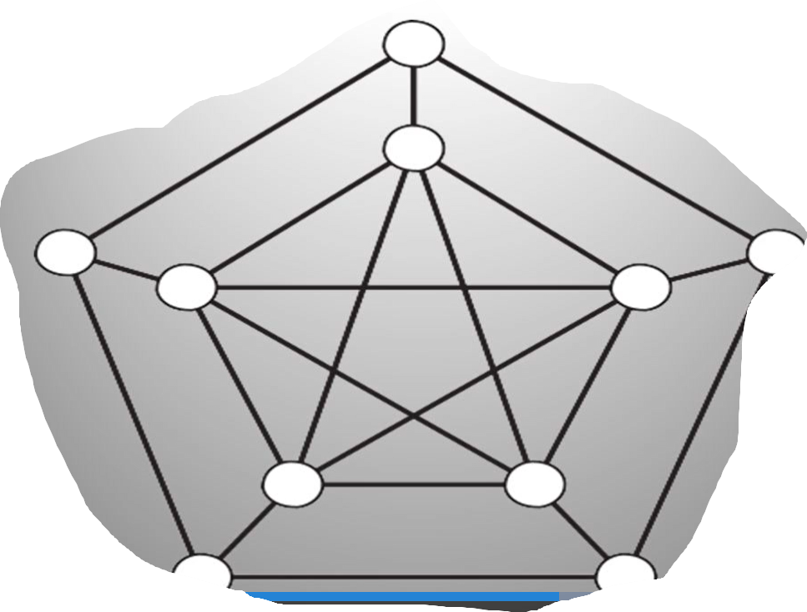
Graph Theory and its Applications
Graph Coloring

Slide 10
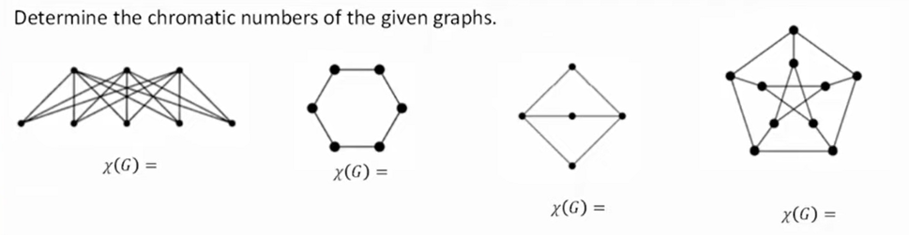
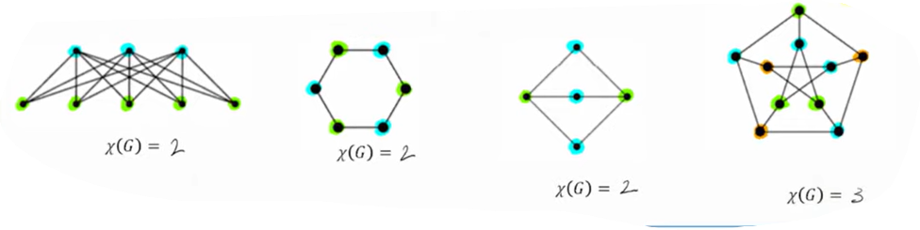
Graph Theory and its Applications
Graph Coloring

Slide 11
Graph Theory and its Applications
Applications of Graph Coloring
Assignment
Map coloring
Scheduling the tasks
Sudoku
Prepare time table
Conflict resolution
In the example above, the chromatic number is 3.

Slide 12
Graph Theory and its Applications Graph Coloring
An application of graph coloring in scheduling
Twelve faculty members in a mathematics department serve on the following committees:
Undergraduate education: Sineman, Limitson, Axiomus, Functionini
Graduate Education: Graphian, Vectorades, Functionini, Infinitescu
Colloquium: Lemmeau, Randomov, Proofizaki
Library: Van Sum, Sineman, Lemmeau
Staffing: Graphian, Randomov, Vectorades, Limitson
Promotion: Vectorades, Van Sum, Parabolton
The committees must all meet during the first week of classes, but there are only three time slots available. Find a schedule that will allow all faculty members to attend the meetings of all committees on which they serve.

Slide 13
Graph Theory and its Applications Graph Coloring
An application of graph coloring in exam scheduling
Suppose that in a particular quarter there are students taking each of the following combinations of courses:
Math, English, Biology, Chemistry
Math, English, Computer Science, Geography
Biology, Psychology, Geography, Spanish
Biology, Computer Science, History, French
English, Psychology, Computer Science, History
Psychology, Chemistry, Computer Science, French
Psychology, Geography, History, Spanish
What is the minimum number of examination periods required for the exams in the ten courses specified so that students taking any of the given combinations of courses have no conflicts? Find a schedule that uses this minimum number of periods.

Slide 14






Graph Theory and its Applications Graph Coloring
An application of graph coloring in exam scheduling
8.02
6.042
18.02
assign times:
M 9am M 1pm
T 9am T 1pm
3.091
4 time slots (best possible)
6.001

Slide 15

Graph Theory and its Applications Graph Coloring
flights need gates, but times overlap. how many gates needed?
time
122
145
Flight Gates
Flights
67
257
306
99

Slide 16

Graph Theory and its Applications Graph Coloring
Coloring the Vertices
257
122
145
assign gates:
67
306
257, 67
122,145
99
306
4 colors
4 gates
99

Slide 17
Graph Theory and its Applications Graph Coloring
Better Coloring
257
122
145
67
306
3 colors
3 gates
99

Slide 18
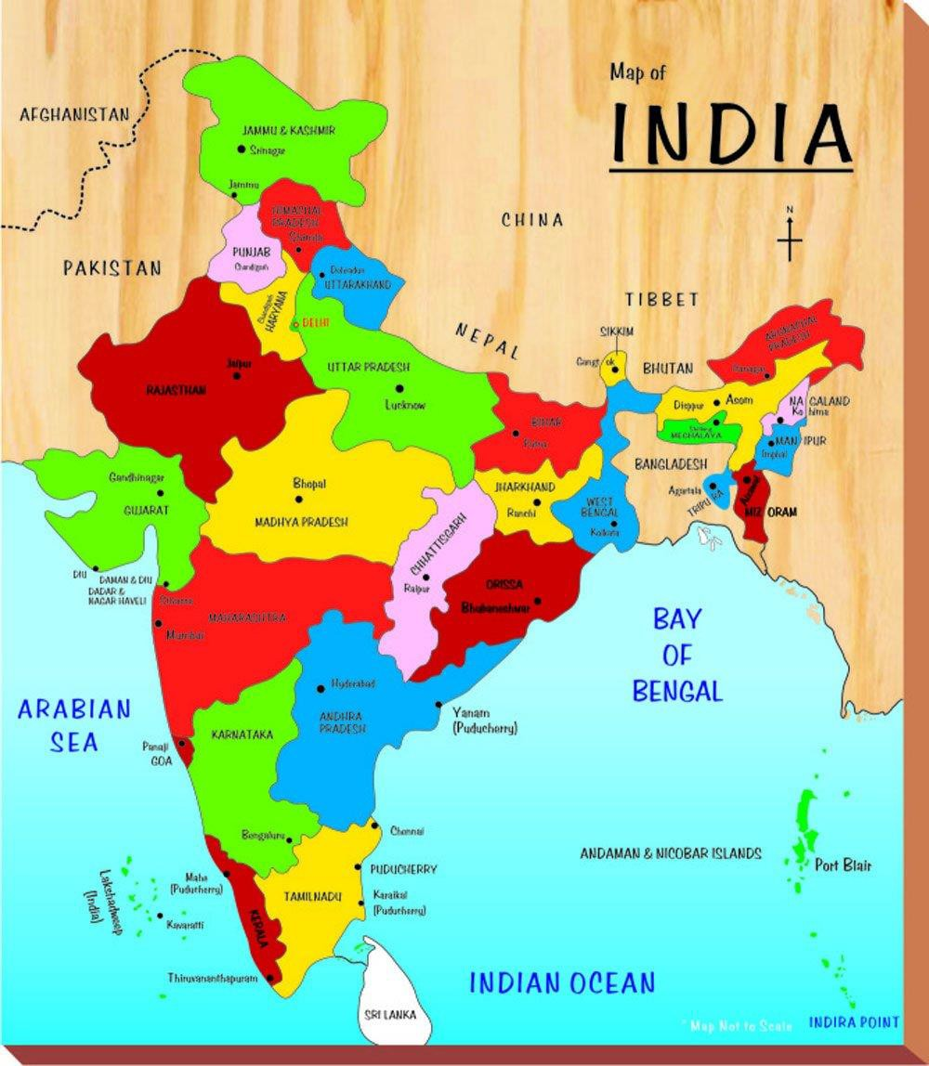
Graph Theory and its Applications Graph Coloring
Map Coloring
Color the map using minimum number of colors so that two states/countries sharing a
border are assigned different colors.

Slide 19
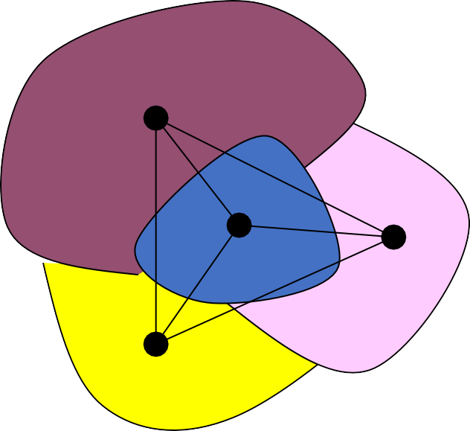
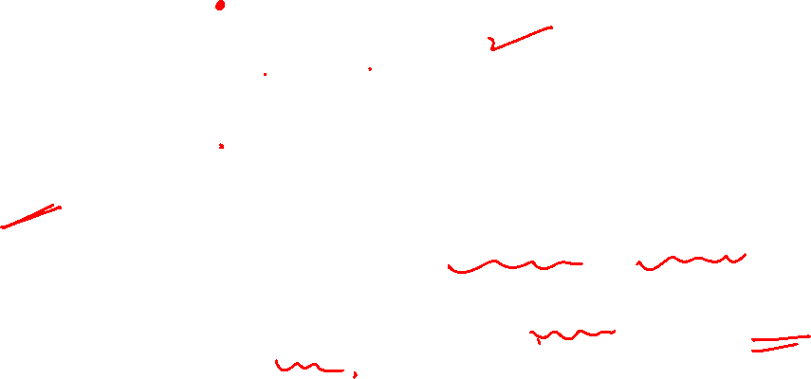
Graph Theory and its Applications Graph Coloring
Planar Graphs
Each vertex is a region.
Two regions have an edge if they are adjacent.
This is a planar graph.
In a planar graph, the chromatic Number must be $≤$4.
Can you paint the world map with only four colors so that no two adjacent countries share the same color? YES

Slide 20
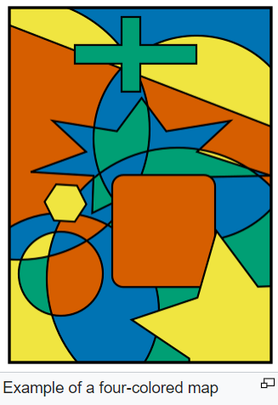

Graph Theory and its Applications Graph Coloring
Four color theorem, or the four color map theorem, states that no more than four colors are required to color the regions of any map so that no two adjacent regions have the same color.
(Adjacent means that two regions share a common boundary curve segment, not merely a corner where three or more regions meet).
https://en.wikipedia.org/wiki/Four_color_theorem

Slide 21
Graph Theory and its Applications Graph Coloring
Map Coloring( Food for thought)
Can we draw a map so that there are 5 countries such that any two of which are adjacent?
NO
Can we draw a map which need 5 colours?
NO
Conjecture (1852) Every map is 4-colourable.
This problem is known as the four color theorem, which states that any planar map can be colored using at most four colors.

Slide 22
Graph Theory and its Applications Graph Coloring
Planar Graphs
Can we draw a map so that there are 5 countries such that any two of which are adjacent?
NO

Slide 23
Graph Theory and its Applications
Graph Coloring
Applications of Graph Coloring
• Making Schedule or Time Table
• Mobile Radio Frequency Assignment: When frequencies are assigned to towers,
frequencies assigned to all towers at the same location must be different
• Sudoku: Sudoku is also a variation of Graph coloring problem where every cell represents a vertex. There is an edge between two vertices if they are in same row or same column or same block.
• Register Allocation: In compiler optimization, register allocation is the process of
assigning a large number of target program variables onto a small number of CPU
registers. This problem is also a graph coloring problem.
• Bipartite Graphs: We can check if a graph is Bipartite or not by coloring the graph using two colors. If a given graph is 2-colorable, then it is Bipartite, otherwise not.
• Map Coloring

Slide 24
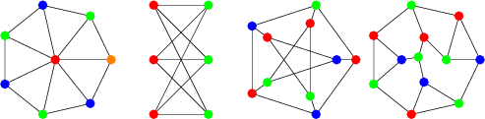
Graph Theory and its Applications Graph Coloring
Vertex Coloring
A vertex coloring is an assignment of labels or colors to each vertex of a graph such that no edge connects two identically colored vertices

Slide 25
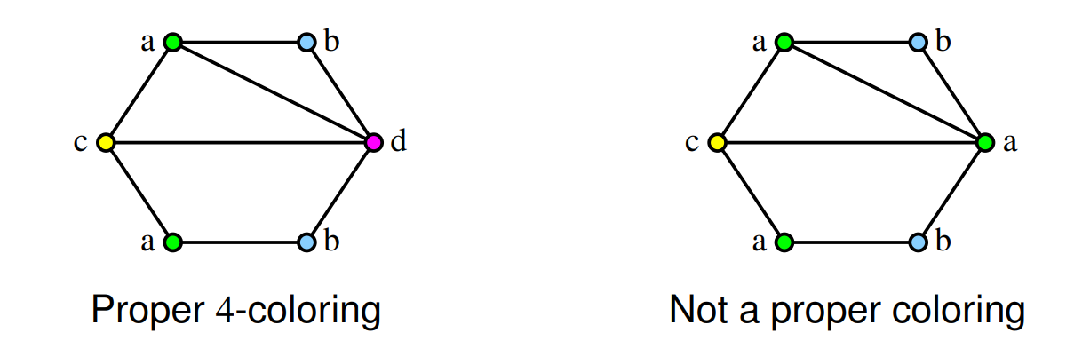
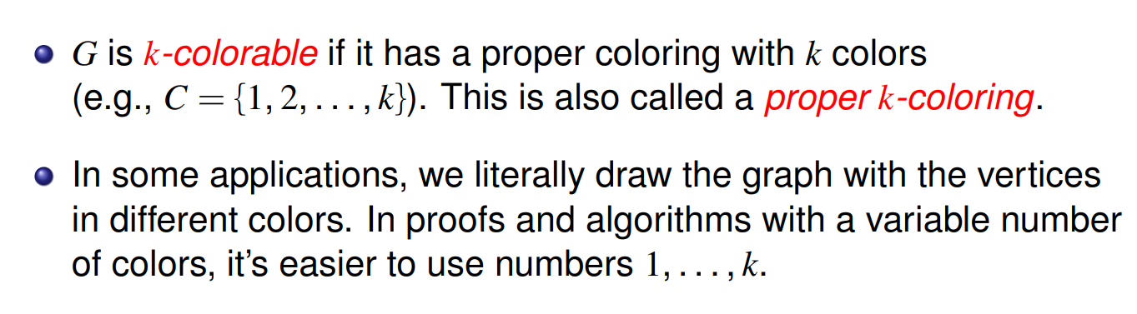
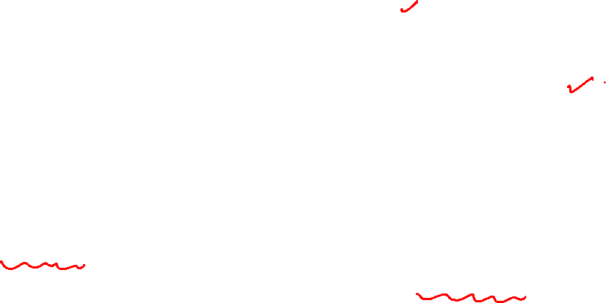
Graph Theory and its Applications Graph Coloring

Slide 26
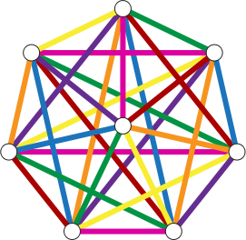
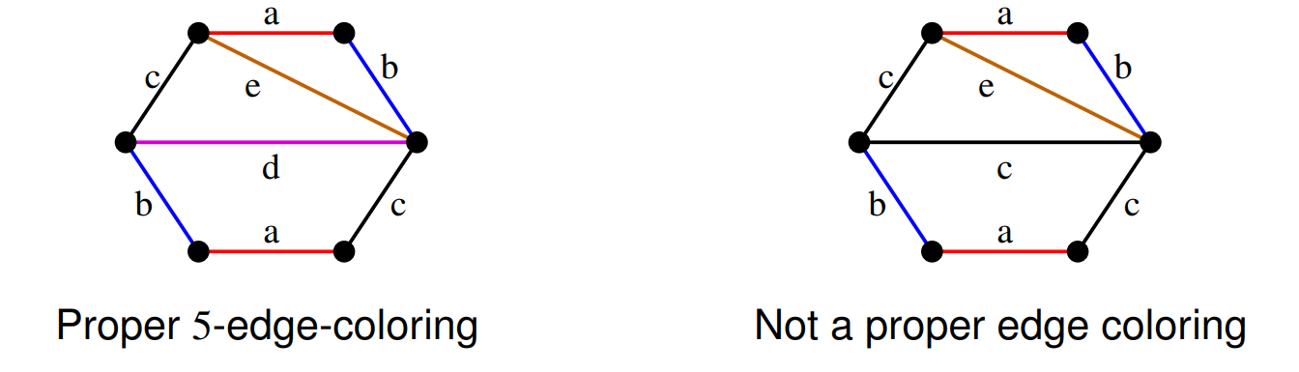

Graph Theory and its Applications Graph Coloring
Edge Coloring
Similar to vertex coloring, except edges are color.
Adjacent edges have different colors.

Slide 27
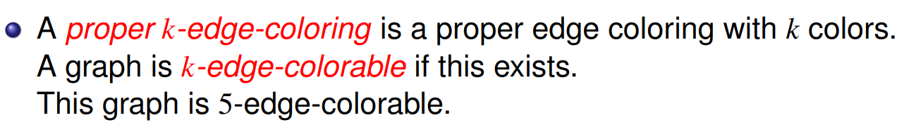
Graph Theory and its Applications Graph Coloring
Edge Coloring

Slide 28
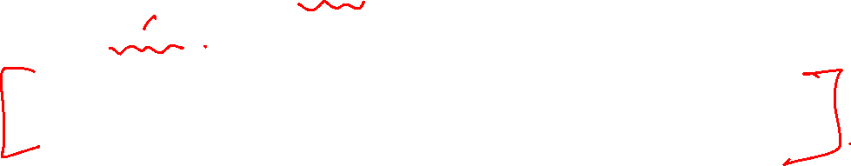
Graph Theory and its Applications Graph Coloring
Edge Coloring
Every edge-coloring problem can be transformed into a vertex-coloring problem.
Not every vertex-coloring problem can be transformed to an edge-coloring problem
CHECK OUT Line graph and how edge coloring and vertex coloring are related in context of Line graph L(G).

Slide 29
K-colorable
Graph Theory and its Applications Graph Coloring
A graph G is k-colorable if it has a k-coloring.
Chromatic Number:
The smallest integer k for which G is k-colorable is called the chromatic number of G, is denoted by the χ(G).

Slide 30
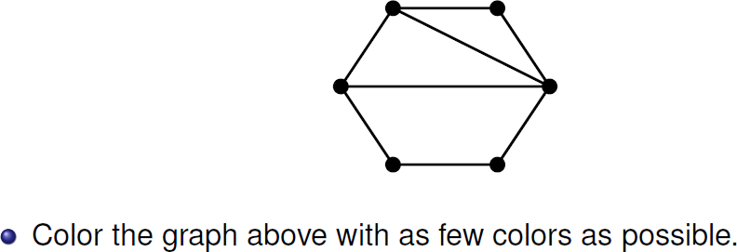
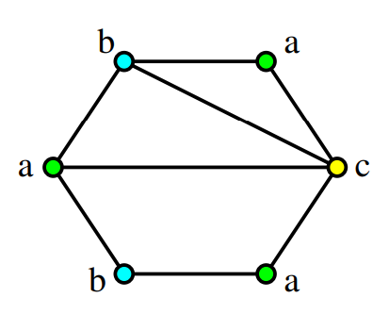
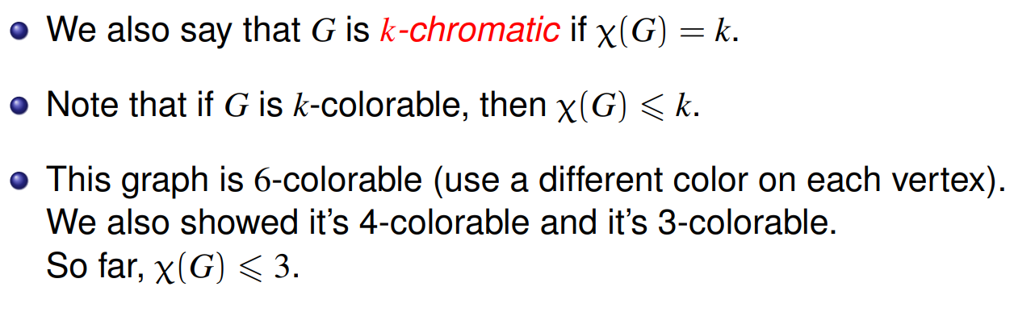
Graph Theory and its Applications Graph Coloring
Vertex coloring problem

Slide 31
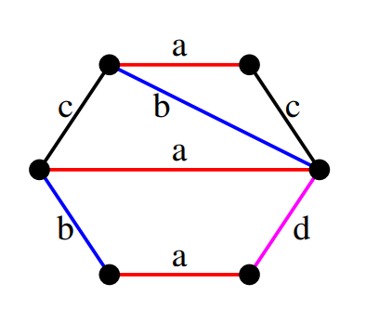
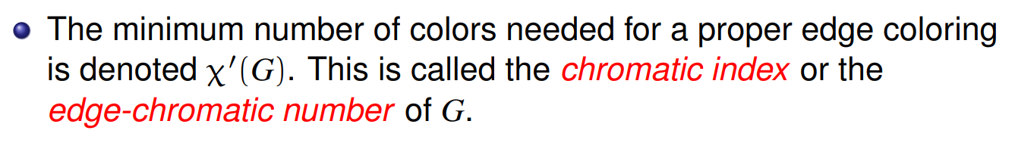
Graph Theory and its Applications Graph Coloring
Edge coloring problem

Slide 32
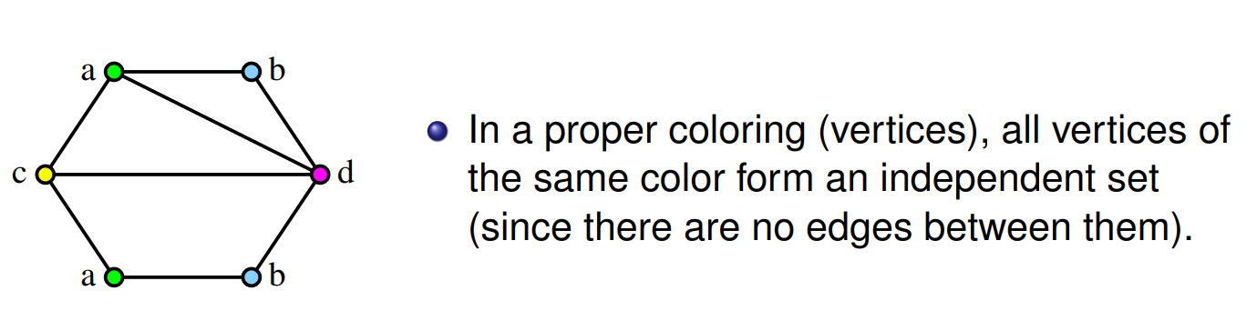
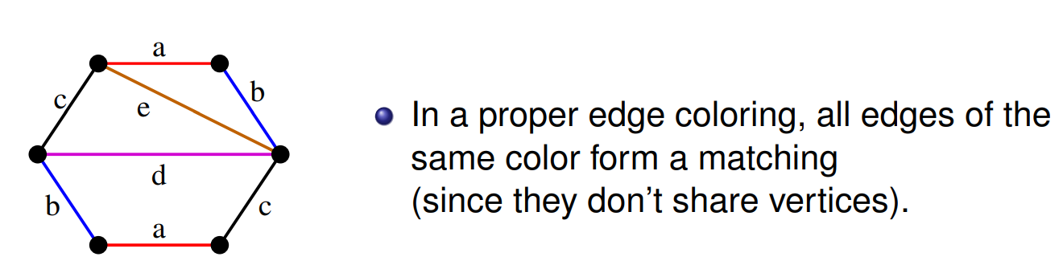
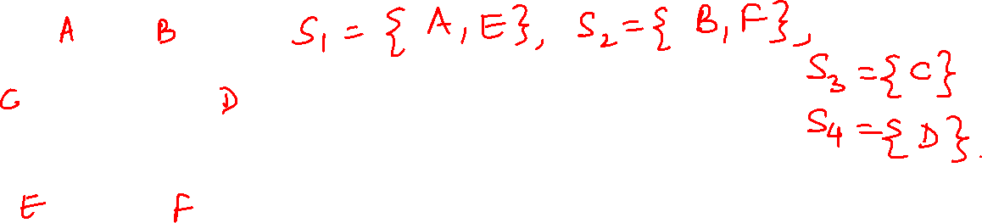
Graph Theory and its Applications Graph Coloring
https://mathweb.ucsd.edu/~gptesler/154/slides/154_graphcoloring_20-handout.pdf

Slide 33
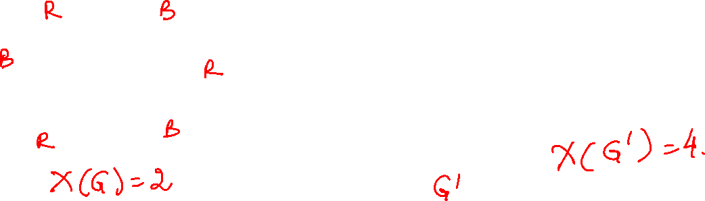
Graph Theory and its Applications Graph Coloring
Find the chromatic number of the following graphs

Slide 34
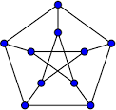
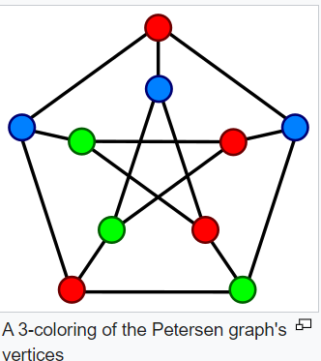
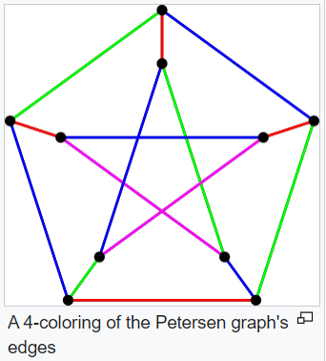
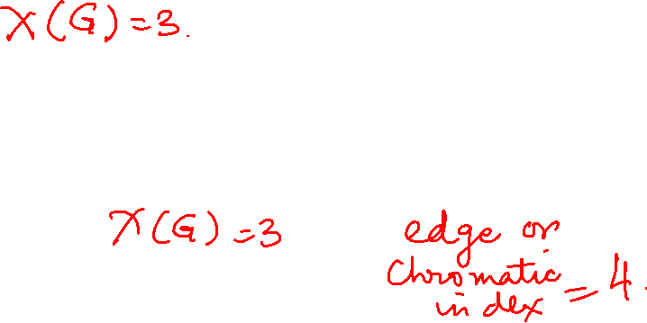
Graph Theory and its Applications Graph Coloring
Find the chromatic number of the following graphs

Slide 35
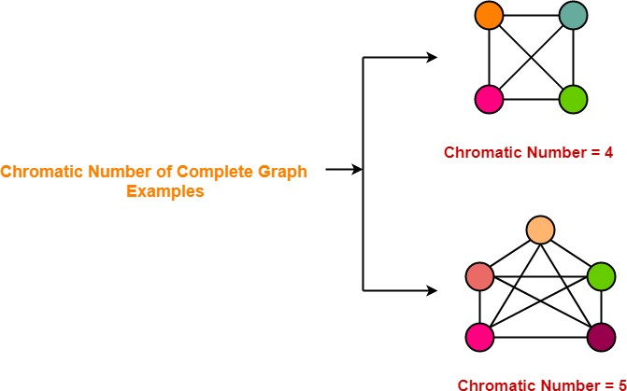
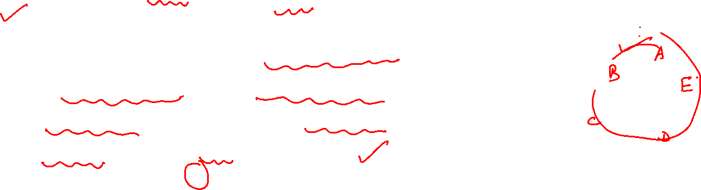
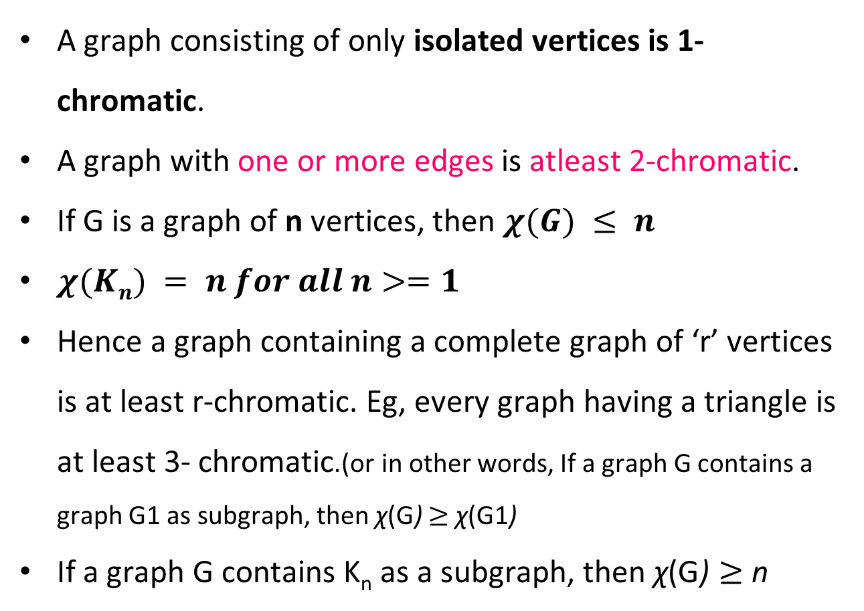
Graph Theory and its Applications
Graph Coloring: Some important Points
A graph consisting of only isolated vertices is 1- chromatic.
A graph with one or more edges is atleast 2-chromatic.
If G is a graph of n vertices, then $χ(G) ≤ n$
$χ(Kn) = n for all n>=1$
Hence a graph containing a complete graph of ‘r’ vertices is at least r-chromatic. Eg, every graph having a triangle is at least 3- chromatic.(or in other words, If a graph G contains a graph G1 as subgraph, then χ(G) $≥$ χ(G1)
If a graph G contains K_{n} as a subgraph, then χ(G) $≥$ n

Slide 36
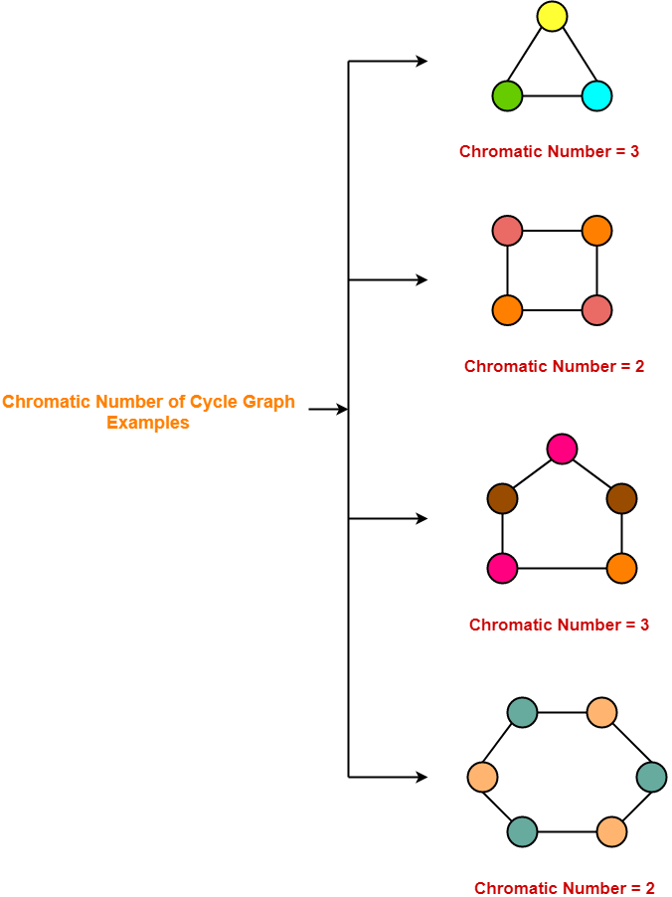
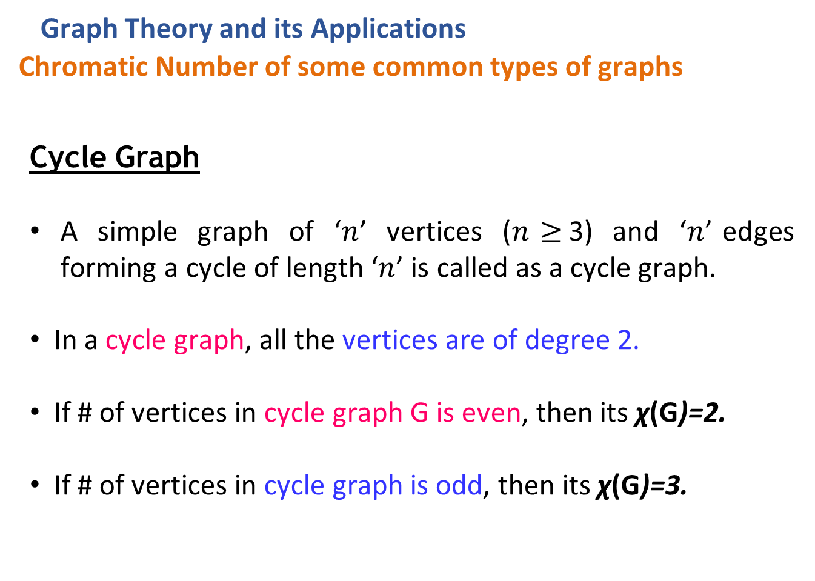
Graph Theory and its Applications
Chromatic Number of some common types of graphs
Cycle Graph
A simple graph of ‘$n$’ vertices ($n$ $≥$3) and ‘$n$’ edges forming a cycle of length ‘$n$’ is called as a cycle graph.
In a cycle graph, all the vertices are of degree 2.
If # of vertices in cycle graph G is even, then its χ(G)=2.
If # of vertices in cycle graph is odd, then its χ(G)=3.

Slide 37
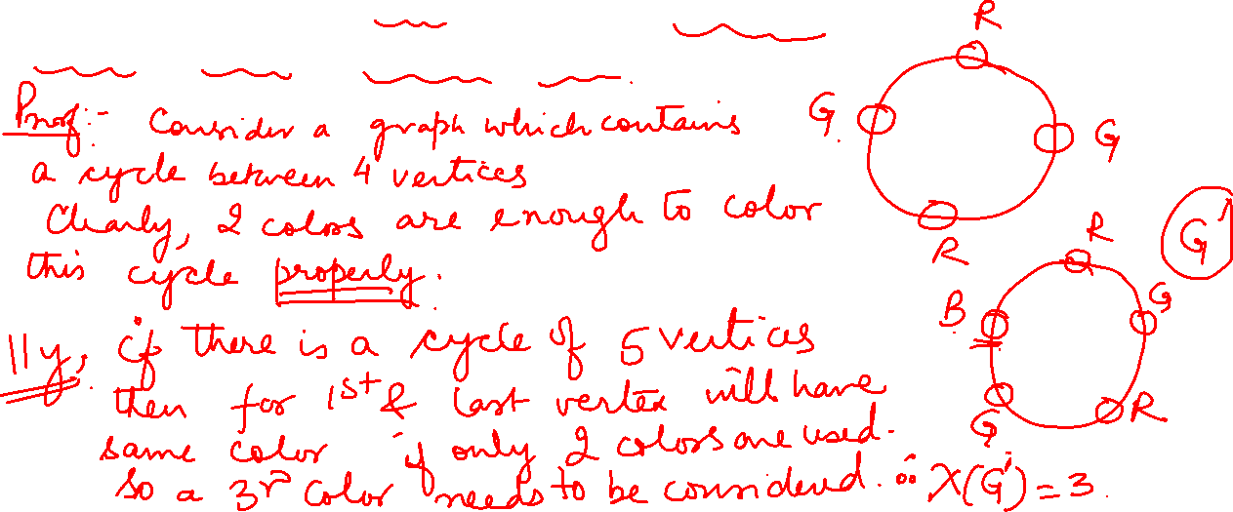
Graph Theory and its Applications Graph Coloring
Prove that a graph of order n>=2 consisting of a single cycle is 2-
chromatic if n is even and 3-chromatic if n is odd.

Slide 38
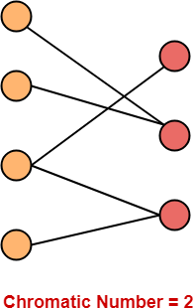
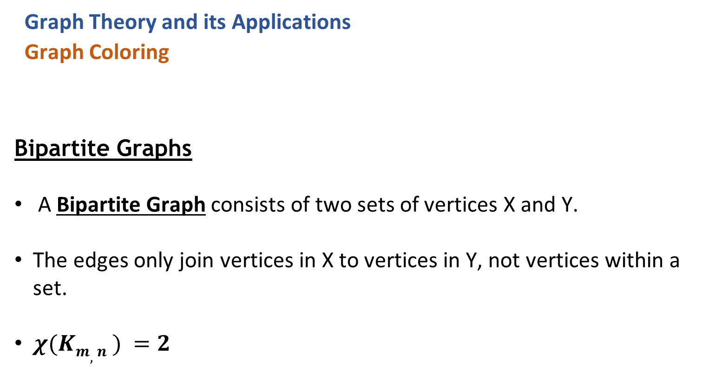
Graph Theory and its Applications
Graph Coloring
Bipartite Graphs
A Bipartite Graph consists of two sets of vertices X and Y.
The edges only join vertices in X to vertices in Y, not vertices within a set.
$χ(Km,n ) =2$

Slide 39
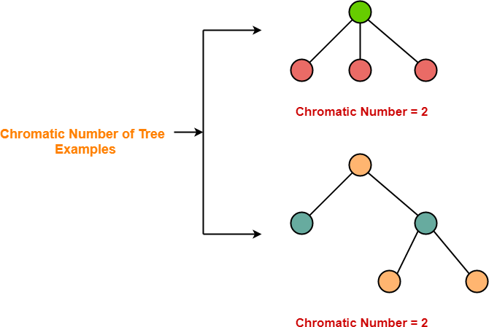
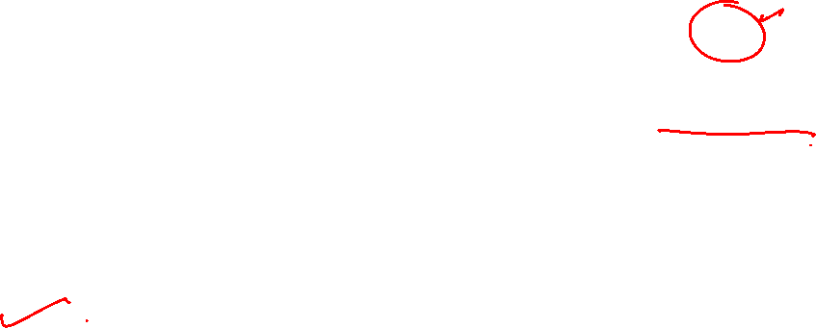
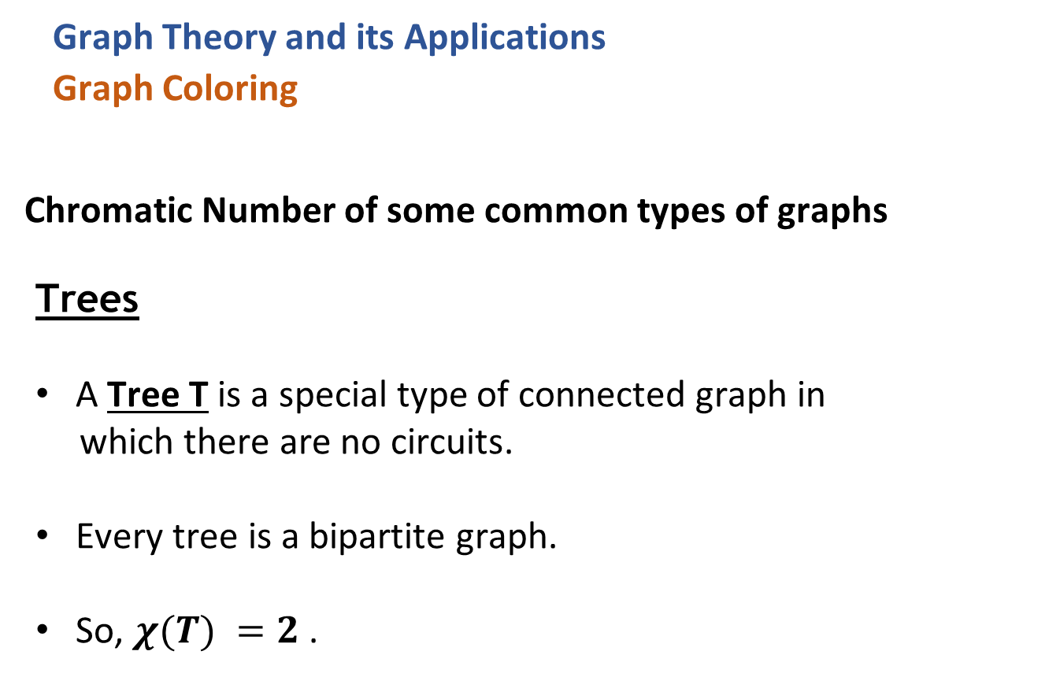
Graph Theory and its Applications
Graph Coloring
Chromatic Number of some common types of graphs
Trees
A Tree T is a special type of connected graph in
which there are no circuits.
Every tree is a bipartite graph.
So, $χ(T) =2$.

Slide 40
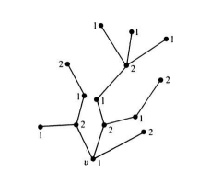
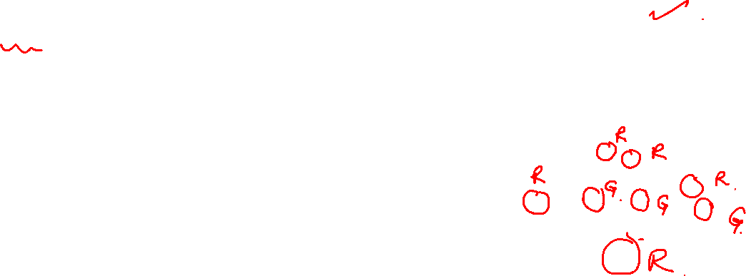
Graph Theory and its Applications
Graph Coloring
Theorem: Every Tree with two or more vertices is 2-chromatic Proof: Select any vertex v in the given tree T. Consider T as a rooted tree at vertex v.
Color v with Red(1). Color all vertices adjacent to v with Green(2).
Then, color the vertices adjacent to these green vertices using Red.
Continue like this till every vertex in T has been colored. Now in T we find that all vertices at odd distances from v have color 2, while v and vertices at even distances from v have color 1. Now along any path in T the vertices are of alternating colors. Since there is one and only one path between any two vertices in a tree, no two adjacent vertices have the same color. Thus T has been properly colored with two colors.

Slide 41

Graph Theory and its Applications Graph Coloring
Theorem: A graph with atleast one edge is 2-chromatic if and only if it has no circuits of odd length

Slide 42


Graph Theory and its Applications
Graph Coloring
Graph Coloring Algorithm
$∃$no efficient algorithm for coloring a graph with minimum number of colors.
Graph Coloring is a NP-complete problem.
But, a greedy algorithm is known for finding the chromatic number of any given
graph.

Slide 43
Graph Theory and its Applications
Graph Coloring
Greedy Algorithm
Color first vertex with the Color 1.
Now, consider the remaining (n-1) vertices one by one and do the following-
Color the currently picked vertex with the lowest numbered color if it has not
been used to color any of its adjacent vertices.
If it has been used, then choose the next least numbered color.
If all the previously used colors have been used, then assign a new color to the currently picked vertex.

Slide 44




Graph Theory and its Applications
Graph Coloring
Greedy Algorithm

Slide 45


Graph Theory and its Applications
Graph Coloring
Greedy Algorithm

Slide 46

Graph Theory and its Applications
Graph Coloring
Greedy Algorithm

Slide 47

Graph Theory and its Applications
Graph Coloring
Greedy Algorithm (Another example)

Slide 48

Graph Theory and its Applications
Graph Coloring
Greedy Algorithm

Slide 49


Graph Theory and its Applications Graph Coloring
Applying Greedy Algorithm, we have-
Vertex | a | b | c | d | e | f
Color | C1 | C2 | C1 | C2 | C1 | C2

Slide 50


Graph Theory and its Applications Graph Coloring
Applying Greedy Algorithm, we have-
Vertex | a | b | c | d | e | f
Color | C1 | C2 | C2 | C3 | C3 | C1

Slide 51


Graph Theory and its Applications Graph Coloring
Applying Greedy Algorithm, we have-
Vertex | a | b | c | d | e | f | g
Color | C1 | C2 | C1 | C3 | C2 | C3 | C4

Slide 52


Graph Theory and its Applications Graph Coloring

Slide 53

Graph Theory and its Applications Graph Coloring
Drawbacks of Greedy Algorithm
There are following drawbacks of the above Greedy Algorithm
The above algorithm does not always use minimum number of colors.
The # of colors used depend on the order in which the vertices are processed.

Slide 54




Graph Theory and its Applications Graph Coloring
Drawback of Greedy Algorithm
v2
v3
v1
v4
v5
V1, V2, V3, V4, V5 V5, V4, V3, V2, V1

Slide 55
Graph Theory and its Applications Graph Coloring
Welsh Powell Graph coloring Algorithm
Find the degree of each vertex
List the vertices in order of descending degrees.
Color the first vertex with color 1.
Move down the list and color all the vertices not connected to the colored vertex, with the same color.
Repeat step 4 on all uncolored vertices with a new color, in descending order of degrees
until all the vertices are colored.

Slide 56


Graph Theory and its Applications Graph Coloring
Welsh Powell Graph coloring Algorithm

Slide 57

Graph Theory and its Applications Graph Coloring
First, order the list in descending order of degrees. Incase of tie, we can randomly choose any ways to break it. So, the new order will be : H, K, D, G, I, J, A, B, E, F, C | Vertex | Degree
 | A | 2
 | B | 2
 | C | 1
 | D | 4
 | E | 2
 | F | 2
 | G | 3
 | H | 5
 | I | 3
 | J | 3
 | K | 5

Slide 58




Graph Theory and its Applications Graph Coloring
H, K, D, G, I, J, A, B, E, F, C

Slide 59
Graph Theory and its Applications Graph Coloring
Apply Welsh Powell Algorithm to color the graph

Slide 60




Graph Theory and its Applications Graph Coloring
Apply Welsh Powell Algorithm to color the graph

Slide 61


Graph Theory and its Applications Graph Coloring
Apply Welsh Powell Algorithm to color the graph

Slide 62



Graph Theory and its Applications Graph Coloring
Apply Welsh Powell Algorithm to color the graph

Slide 63
THANK YOU
Dr. Arti Arya
Department of Computer Science &Engineering
artiarya@pes.edu

